Slide 1

CISCO NETWORK ESSENTIALS
GOVT. ENGINEERING COLLEGE, BILASPUR
Submited By:
GEETANJALI MARKAM (Roll No. 300702217302)
PRADEEP KUMAR (Roll No. 300702217304)
PRAKASH SINHA (Roll No. 300702217305)
RUBY PATEL (Roll No. 300702217306)
SURENDRA KUMAR (Roll No. 300702217307)
SUSHMA (Roll No. 300702217308)
VIJAY KUMAR (Roll No. 300702216036)

Slide 2
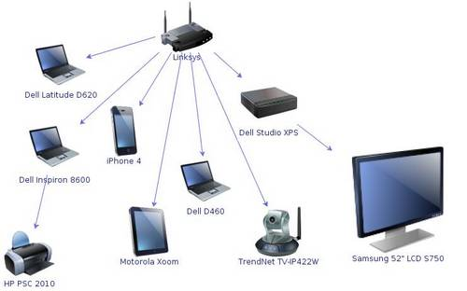
1. INTRODUCTION
COMPUTER NETWORK
NETWORK DEVICES
NETWORK MEDIA
STRUCTURE CABLING

Slide 3
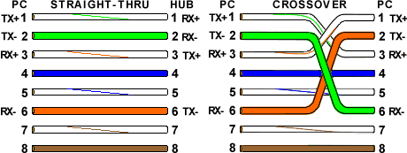
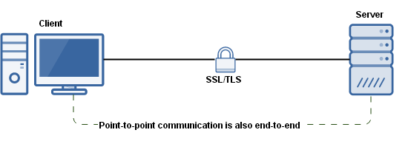
2. NETWORK STANDARD
IEEE STANDARD
COLUR CODING STANDARD
CABLE CREATION
PEER TO PEER CONNECTION

Slide 4
3. NETWORK ADDRESSING
PHYSICAL ADDRESSING – MAC
LOGICAL ADDRESSING – IPv4 AND IPv6
SUBNATTING AND SUPERNATING
STATIC AND DYNAMIC ADDRESS ASSIGNING
MAC - 64-00-6A-02-2F-06
IPv4 – 192.168.72.5
IPv6 – 2001:0DB8:AC10:FE01

Slide 5

4. INSTALATION OF OPERATING SYSTEM
CLIENT PCs
SERVER PCs

Slide 6
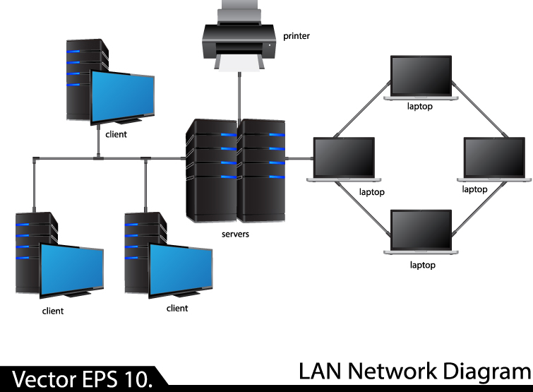
5. CONNECTIVITY
CLIENT AND SERVER CONNECTIVITY
FILE SHARING
REMOT DESKTOP LOGIN

Slide 7
6. CONFIGURATION
DHCP SERVER CONFIGURATION
WEB SERVER CONFIGURATION

Slide 8
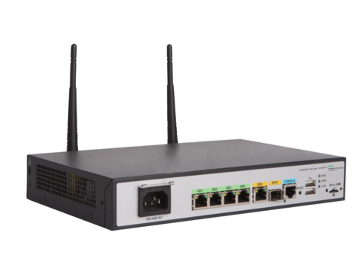
7. ROUTER CONFIGURATION
ROUTER SPECIFICATIONS
CONFIGURATION COMMANDS
PACKET TRACER

Slide 9
?
THANK YOU

